Slide 1
Deploying MongoDB Sharding Clusters in Virtual Box

Slide 2
Step 0: Precondition
Server | Type | Replication Set | Server Alias | IP Address | Port
1 | mongos |  | mongo4 | 192.168.56.110 | 27017
2 | config server | rscfg | config1 | 192.168.56.104 | 27019
3 | config server | rscfg | config2 | 192.168.56.105 | 27019
4 | config server | rscfg | config3 | 192.168.56.106 | 27019
5 | shard server | rs1 | shard1 | 192.168.56.107 | 27018
6 | shard server | rs2 | shard2 | 192.168.56.108 | 27018
*Note: Each VM must be connected to a Host-Only Adapter Network

Slide 3
Step 1: Set Static IP Addresses for each Server and their Aliases
In /etc/network/interfaces:
-> Please refer to Replication slides

Slide 4
Step 1: Set Static IP Addresses for each Server and their Aliases
In /etc/hosts:
-> Please refer to Replication slides

Slide 5
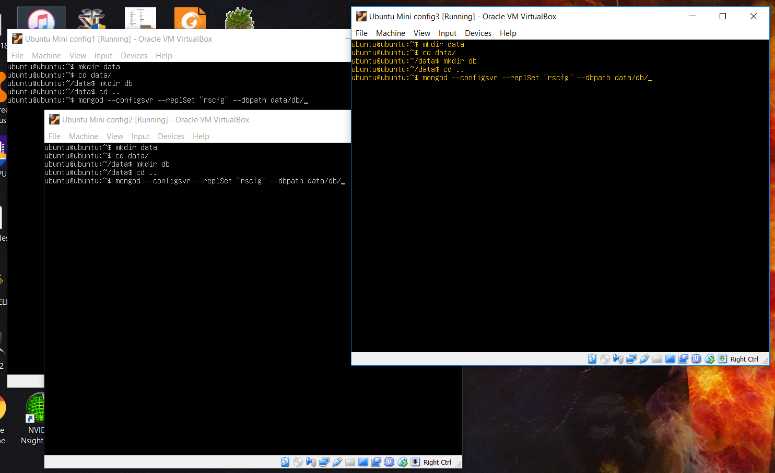
Step 2: Run mongod on each Config Server
>> mongod --configsvr --replSet “rscfg” --dbpath data/db

Slide 6
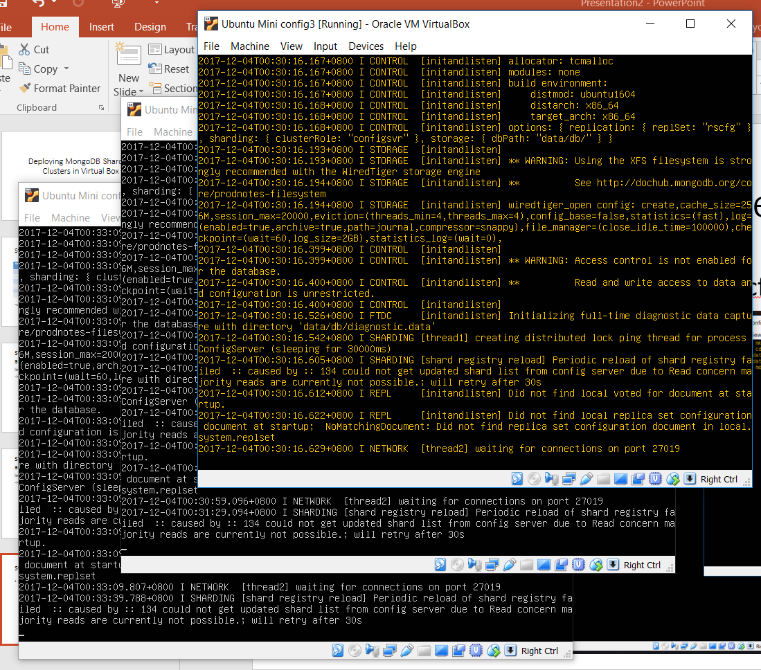
Step 2: Run mongod on each Config Server
Expected result:

Slide 7
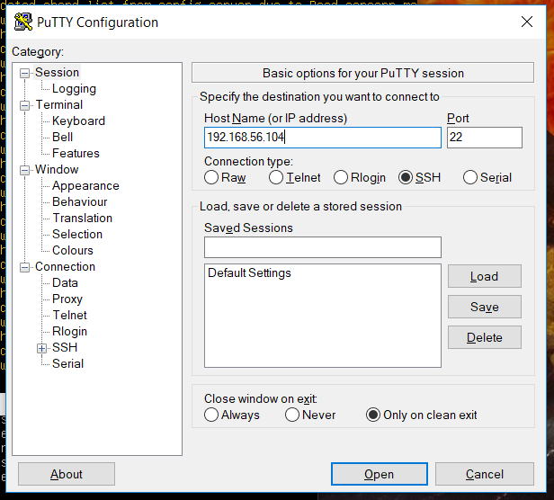
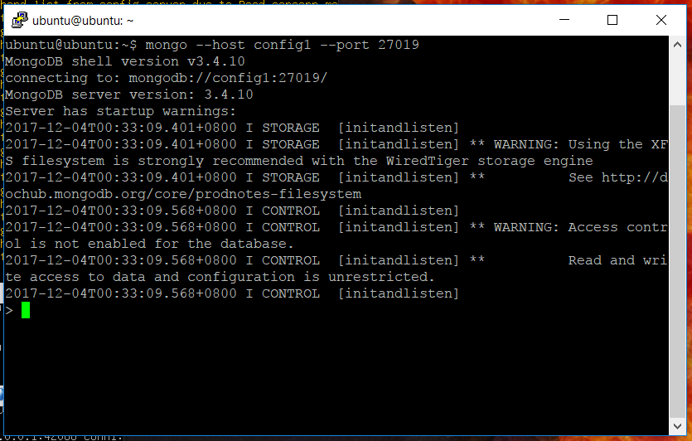
Step 3: Connect to one of the Config Server using Putty and run mongo
>> mongo --host config1 --port 27019

Slide 8
Step 4: Initiate the Replication Set and add all included Config Servers
>>
rs.initiate(
{
_id: "rscfg",
configsvr: true,
members: [
{ _id : 0, host : "config1:27019" },
{ _id : 1, host : "config2:27019" },
{ _id : 2, host : "config3:27019" }
]
}
)

Slide 9
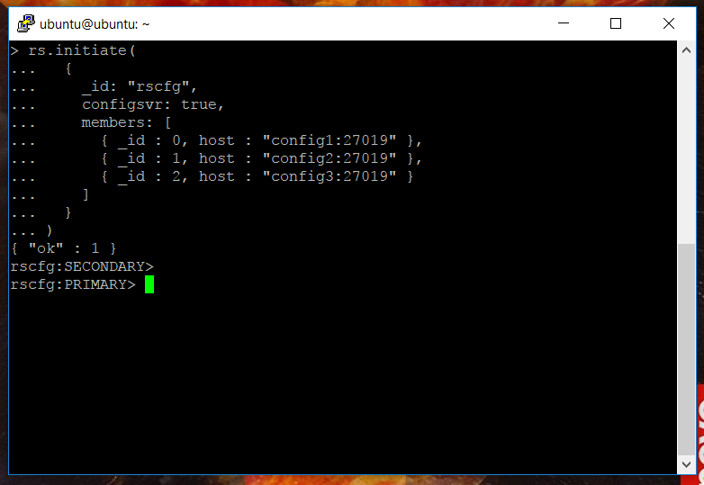
Step 4: Initiate the Replication Set and add all included Config Servers
Expected result:

Slide 10
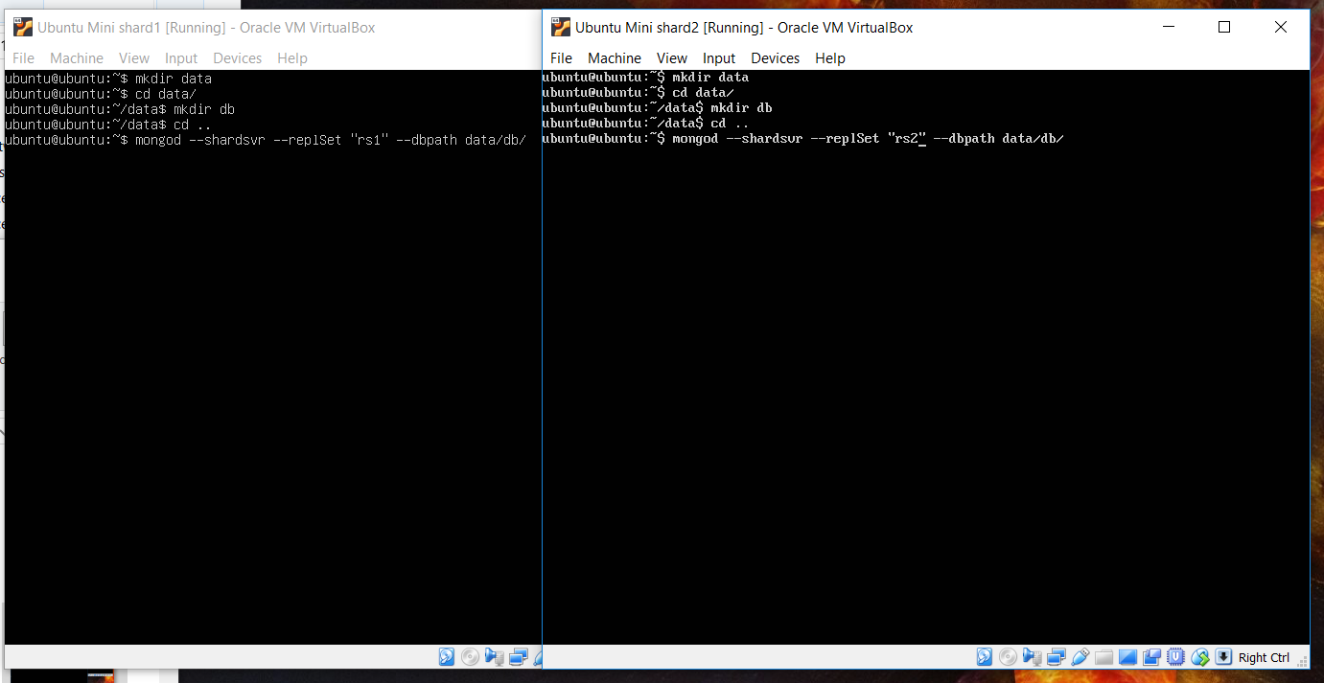
Step 5: Run mongod on each Shard Server
shard1 >> mongod --shardsvr --replSet “rs1” --dbpath data/db
shard2 >> mongod --shardsvr --replSet “rs2” --dbpath data/db

Slide 11
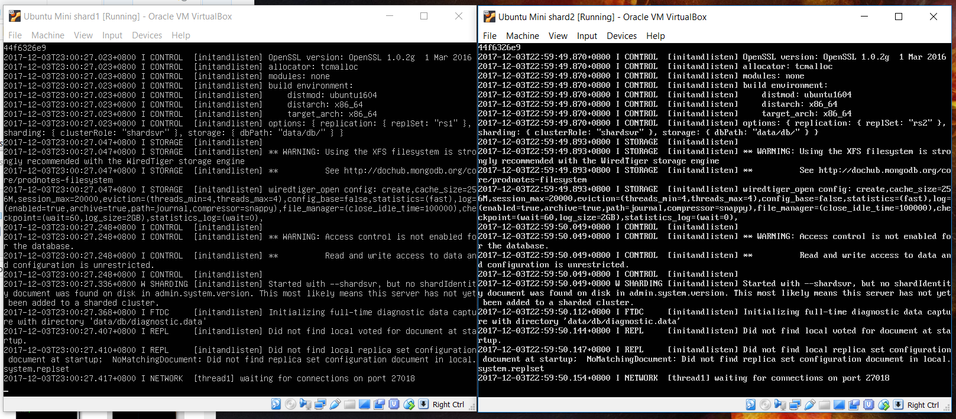
Step 5: Run mongod on each Shard Server
Expected result:

Slide 12
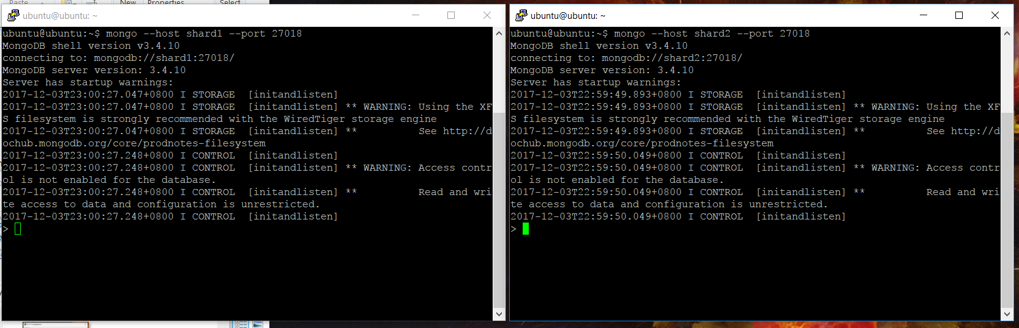
Step 6: Connect to the 2 Shard Servers using Putty and run mongo
shard1 >> mongo --host shard1 --port 27018
shard2 >> mongo --host shard2 --port 27018

Slide 13
Step 7: Initiate each Replication Set and add all included Shard Servers
shard1:mongo >>
rs.initiate(
{
_id : “rs1",
members: [
{ _id : 0, host : "shard1:27018" }
]
}
)
shard2:mongo >>
rs.initiate(
{
_id : “rs2",
members: [
{ _id : 0, host : "shard2:27018" }
]
}
)

Slide 14
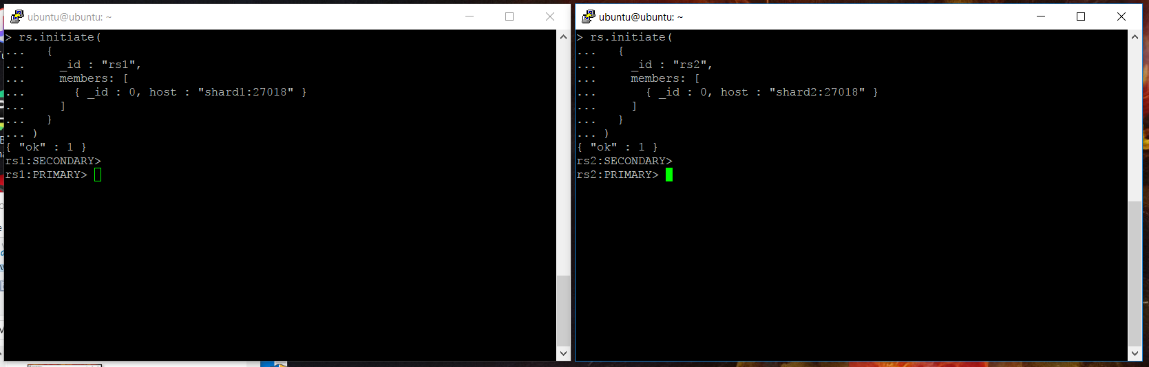
Step 7: Initiate each Replication Set and add all included Shard Servers
Expected result:

Slide 15
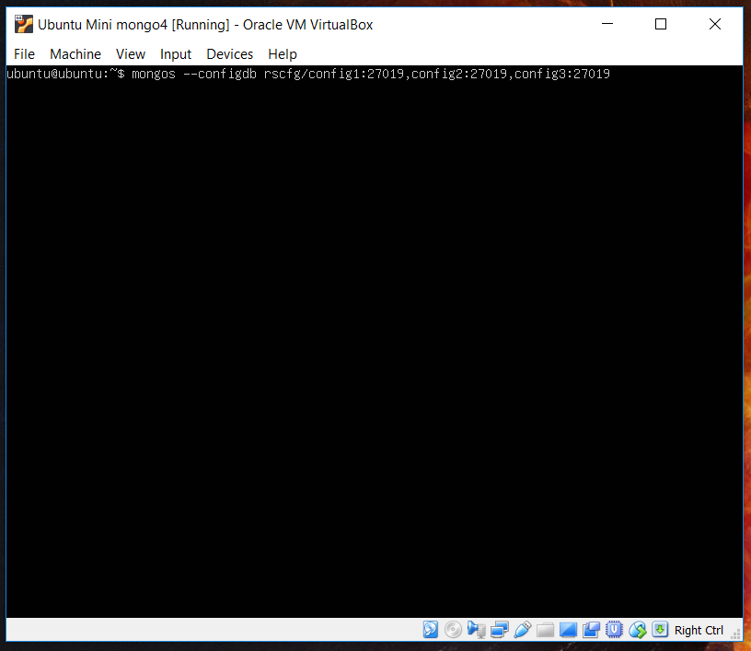
Step 8: Run mongos on App Server
>> mongos --configdb rscfg/config1:27019,config2:27109,config3:27019

Slide 16
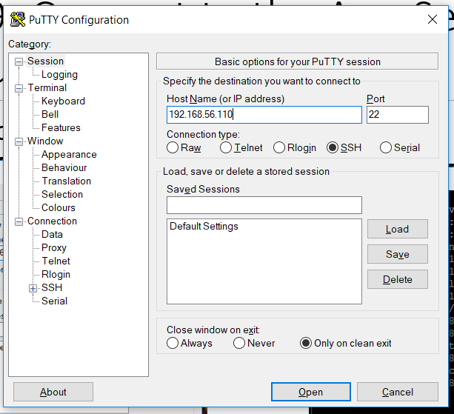
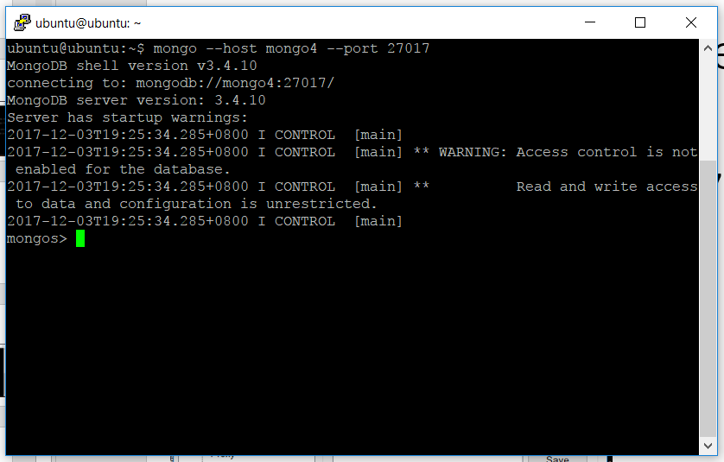
Step 9: Connect to the App Server using Putty and run mongo
>> mongo --host mongo4 --port 27017

Slide 17
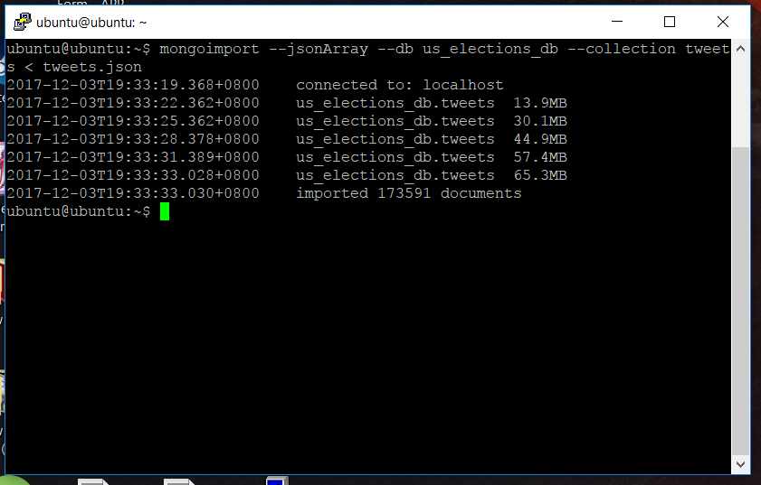
Step 10: Try to add very big data (>64MB)

Slide 18
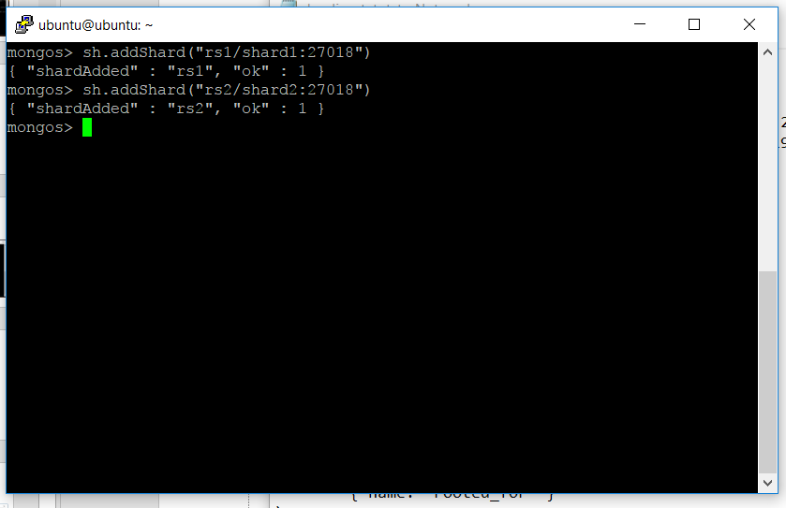
Step 11: Add the Shard Servers
>> sh.addShard(“rs1/shard1:27018")
>> sh.addShard(“rs2/shard2:27018")

Slide 19
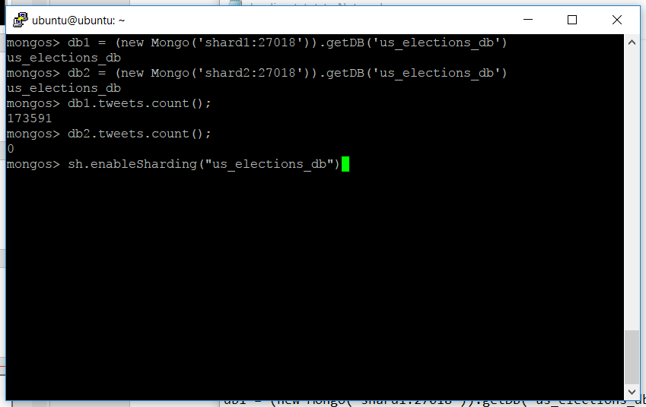
Step 12: Enable Sharding for us_elections_db database
>> sh.enableSharding("tweets")

Slide 20
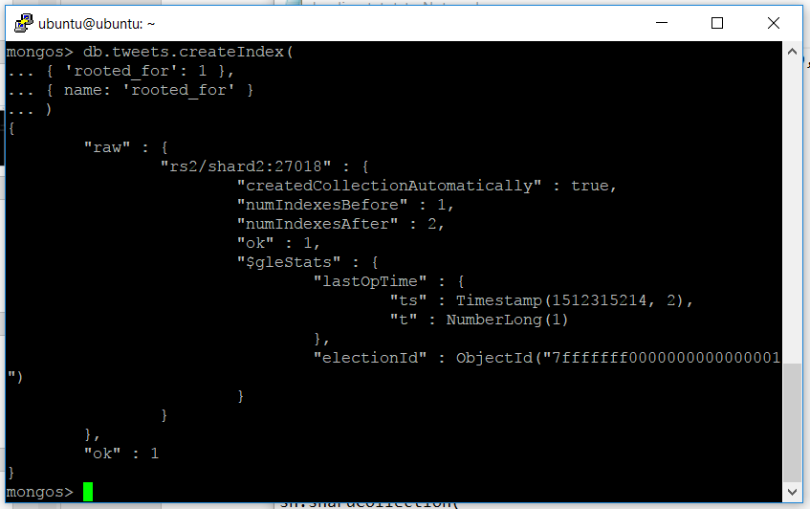
Step 13: Create index for tweets collection based from rooted_for document
>> use us_elections_db
>> db.tweets.createIndex(
{ 'rooted_for': 1 },
{ name: 'rooted_for' }
)

Slide 21
Step 13: Shard the tweets collection
>> sh.shardCollection(
"us_elections_db.tweets",
{ "rooted_for": 1 }
)

Slide 22
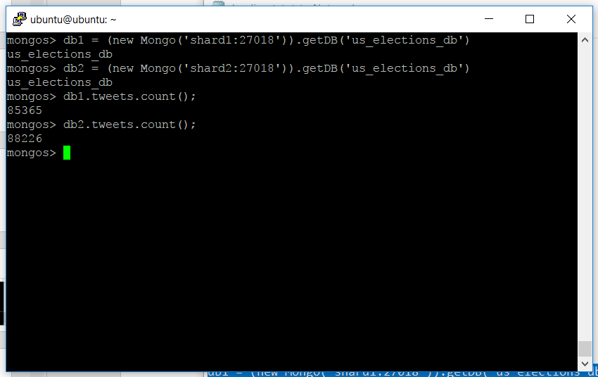
Step 14: Check if tweets collection is sharded

